Slide 1




The EagleSat 2 Structure
Lillian Sudkamp - Fabrications Integrator
Embry-Riddle Aeronautical University Prescott
College of Engineering
Mentor: Dr. Ahmed Sulyman
Arizona Space Grant Symposium
April 6, 2023

Slide 2
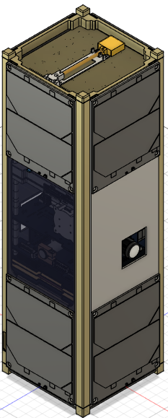
Project Overview
Goal:
  Create a 3U CubeSat structure that can withstand deployment and protect the innerworkings of the satellite

Slide 3
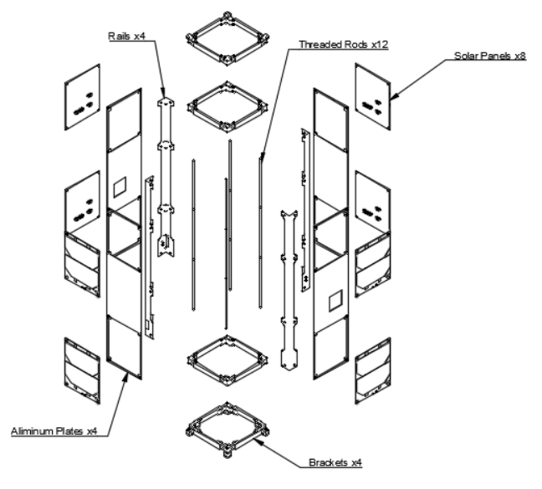
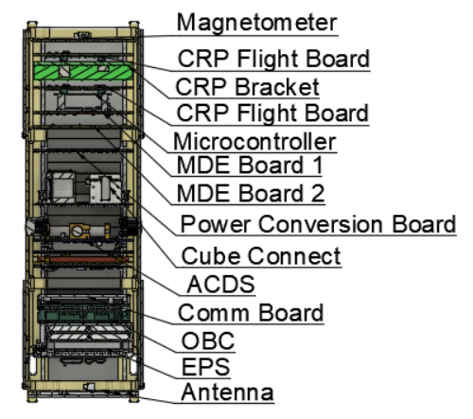
Design
Notes:
Give Design Overview

Slide 4
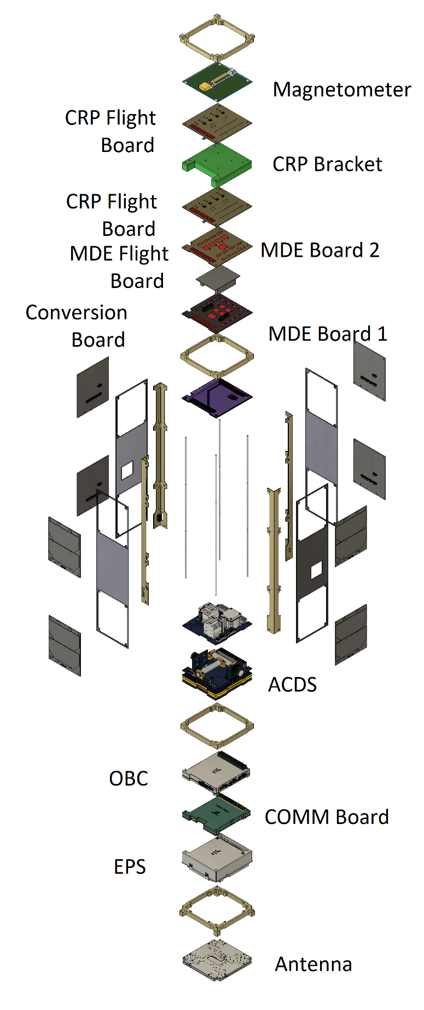
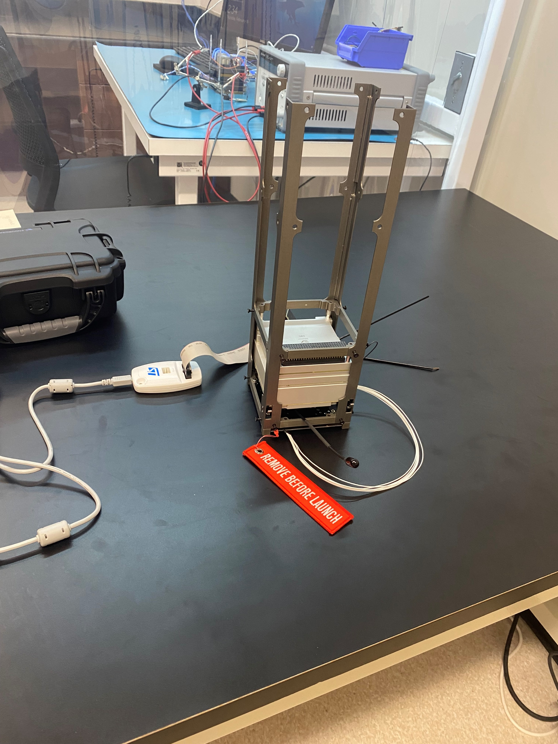
Assembly
Notes:
Talk about how the assembly would operate in an ideal scenario

Slide 5
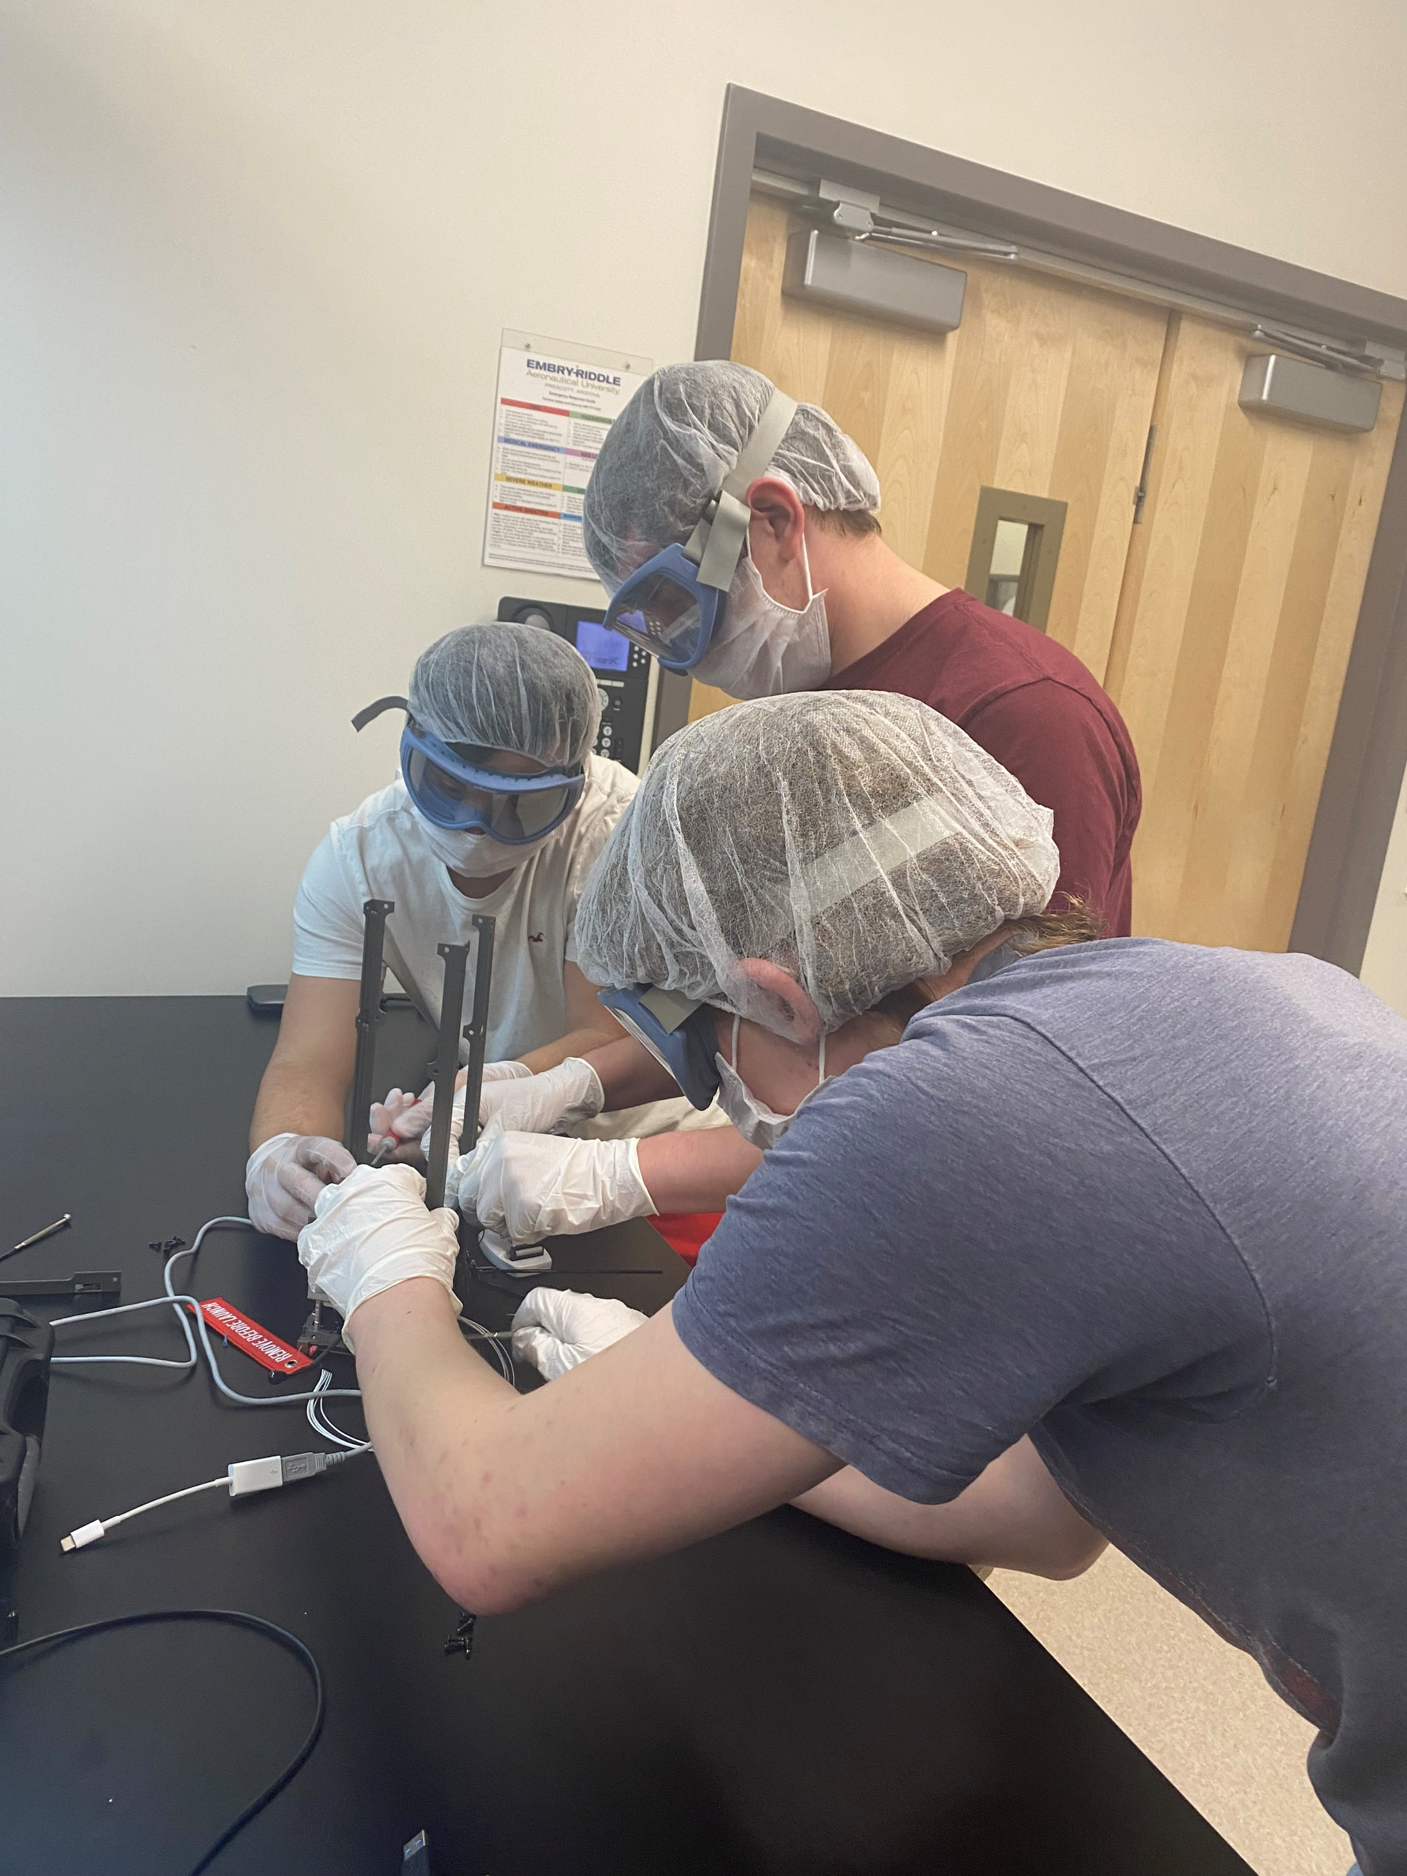
Challenges
Notes:
Talk about challenges that arose
parts not being in in time
how pieces fit together that weren’t ideal
downsides to your design found in the assembly stage

